Slide 1

TypeScript Fundamentals
Anup Vasudeva

Slide 2
Agenda
Session 1
Session 2
Setup
TypeScript: What and Why
Primitive and object types
Type Annotations vs Type Inference
“any” and “unknown” types
Interface
Type alias with union, intersection types
Class
Modules
Enums
Generics

Slide 3
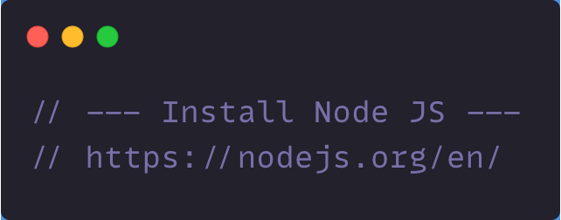
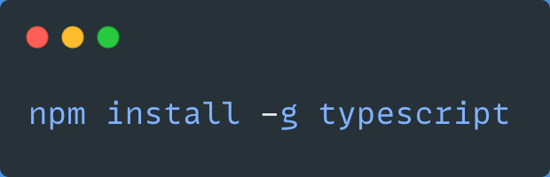
Setup
1
2

Slide 4
What is TypeScript
An optionally-typed superset of JavaScript
Free, Open-sourced, maintained by Microsoft
Compiles to JavaScript (transpiles) with no special runtime
Supports new ECMAScript features
Targets both Node and browser environment
Three pillars:
Language
Language Services
Compiler (tsc)

Slide 5
Why TypeScript
Improved code quality
Type inference
Incremental adoption
Latest and greatest ECMAScript features
Easier refactoring and debugging
Eliminates several class of bugs:
Cannot read property name of undefined
undefined is not a function

Slide 6
Primitive and object types
Primitive
number
string
boolean
null
undefined
symbol
bigint
Object
Arrays
Functions
Objects
Classes

Slide 7
Type System
Type System:
Set of rules that a type-checker uses to assign types to your program
Explicit Type System (Type Annotation)
Implicit Type System (Type Inference)

Slide 8
THANK YOU!!!

